Slide 1
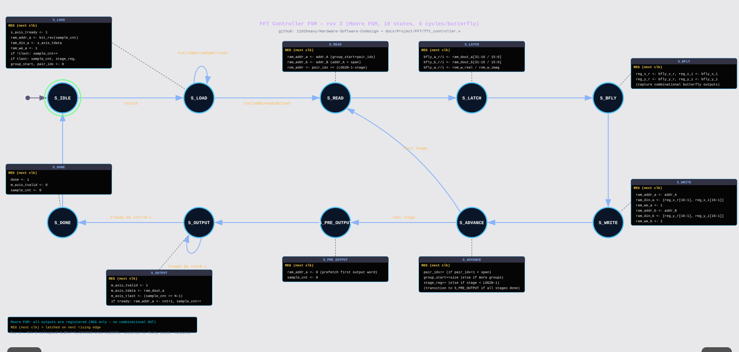
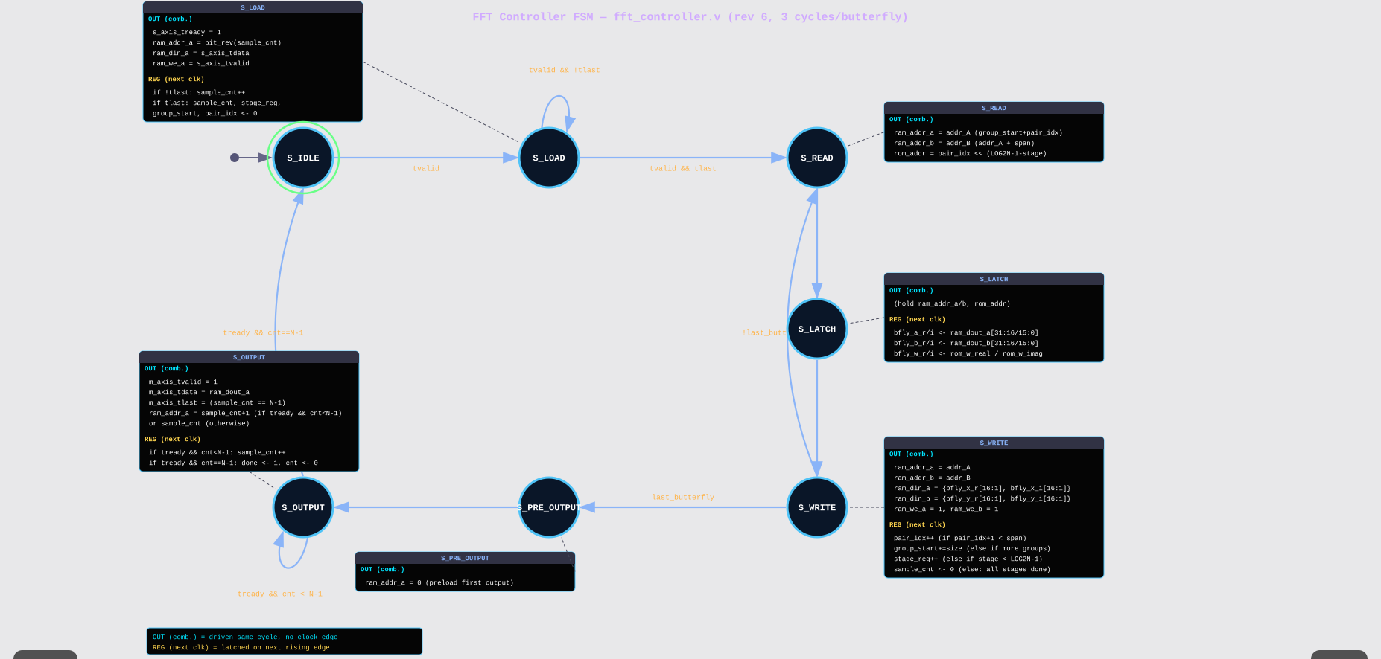
Hardware Architecture

Slide 2
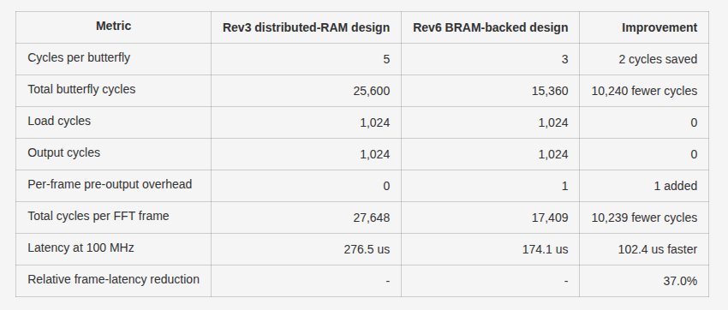
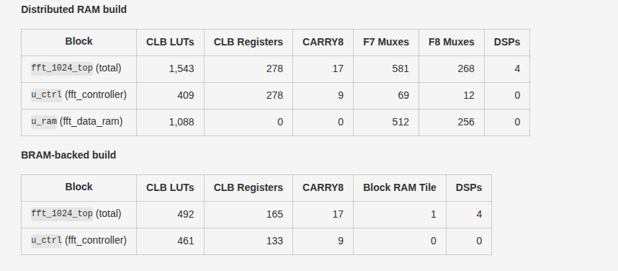
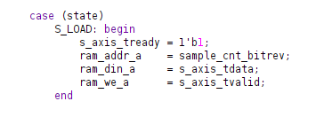


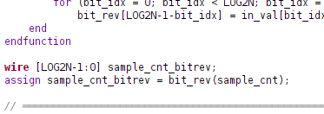
Hardware Optimisation
FSM Latency Shortening
BRAM Optimisation
Bit Reversal optimisation

Slide 3
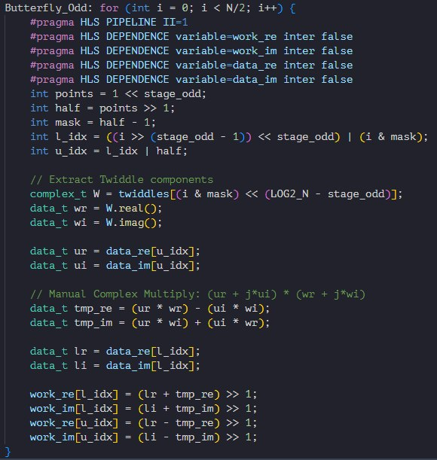
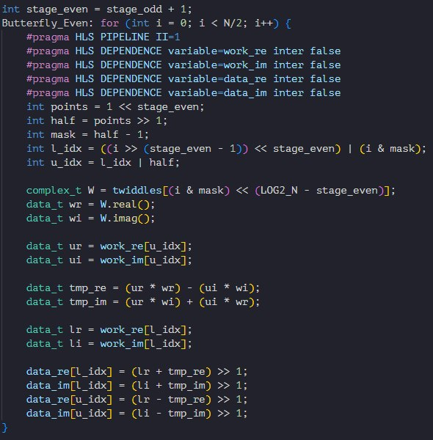
HLS
Double buffering to hit II=1 for pipelining
Dependence Pragma assures vitis there is no conflict with reading and writing the data

Slide 4

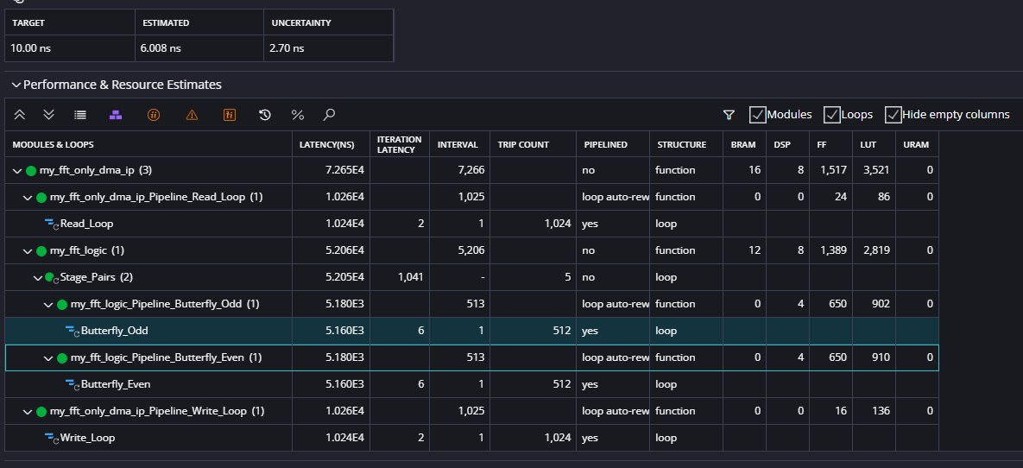
HLS
Unable to hit II=1 Pipelining
V2 can hit II=1 Pipelining

Slide 5
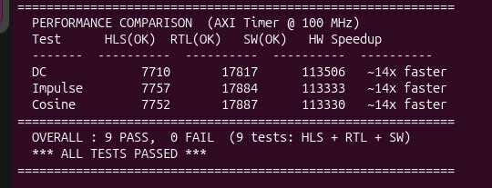
Hardware vs HLS vs Software

